Slide 1

Exploratory Data Analysis
Team- Data Innovator

Slide 2
Agenda
Missing value Treatment
Data Visualization
Data Manipulation
Word Cloud
Cluster analysis
Interesting Insights

Slide 3
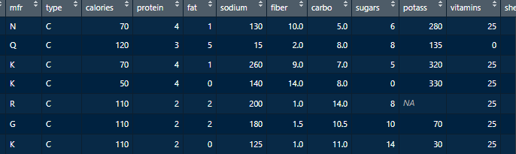
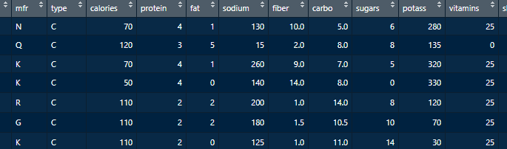
Missing value treatment

Slide 4
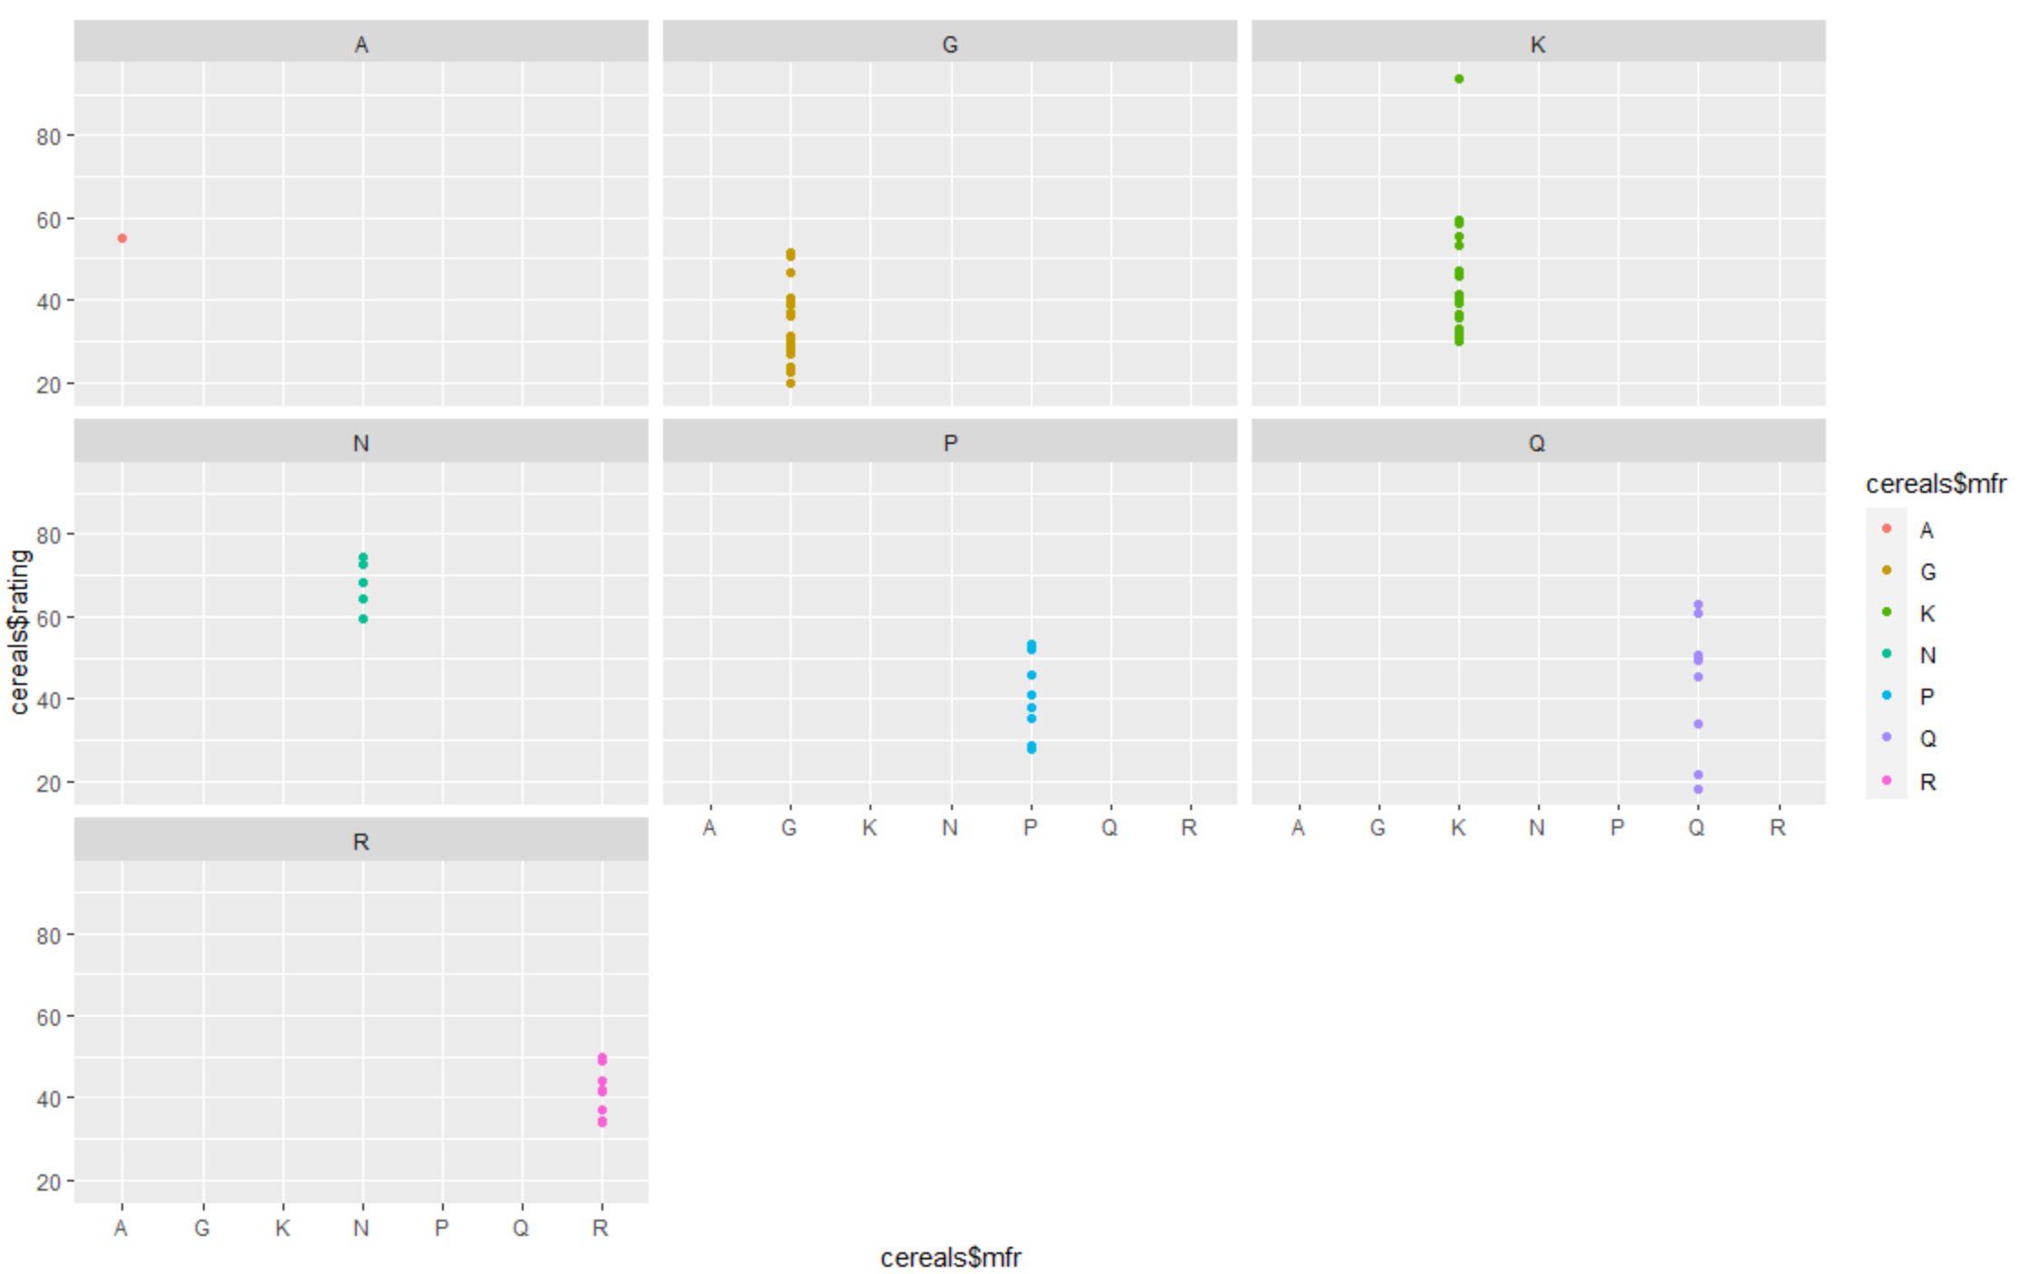
Ratings calculated by Various consumer reports
93.7%
67.9%
34.5%
18.04%
All-Bran_with_Extra_Fiber is the highest rated product. Manufacturer is Kellogs.
Highest average rating of any manufacturer(Nabisco) of cereal.
Least average rating of any manufacturer (General Mills) of cereal.
Cap ‘n’ Crunch is the lowest rated product. Manufacturer is Quaker oats.

Slide 5
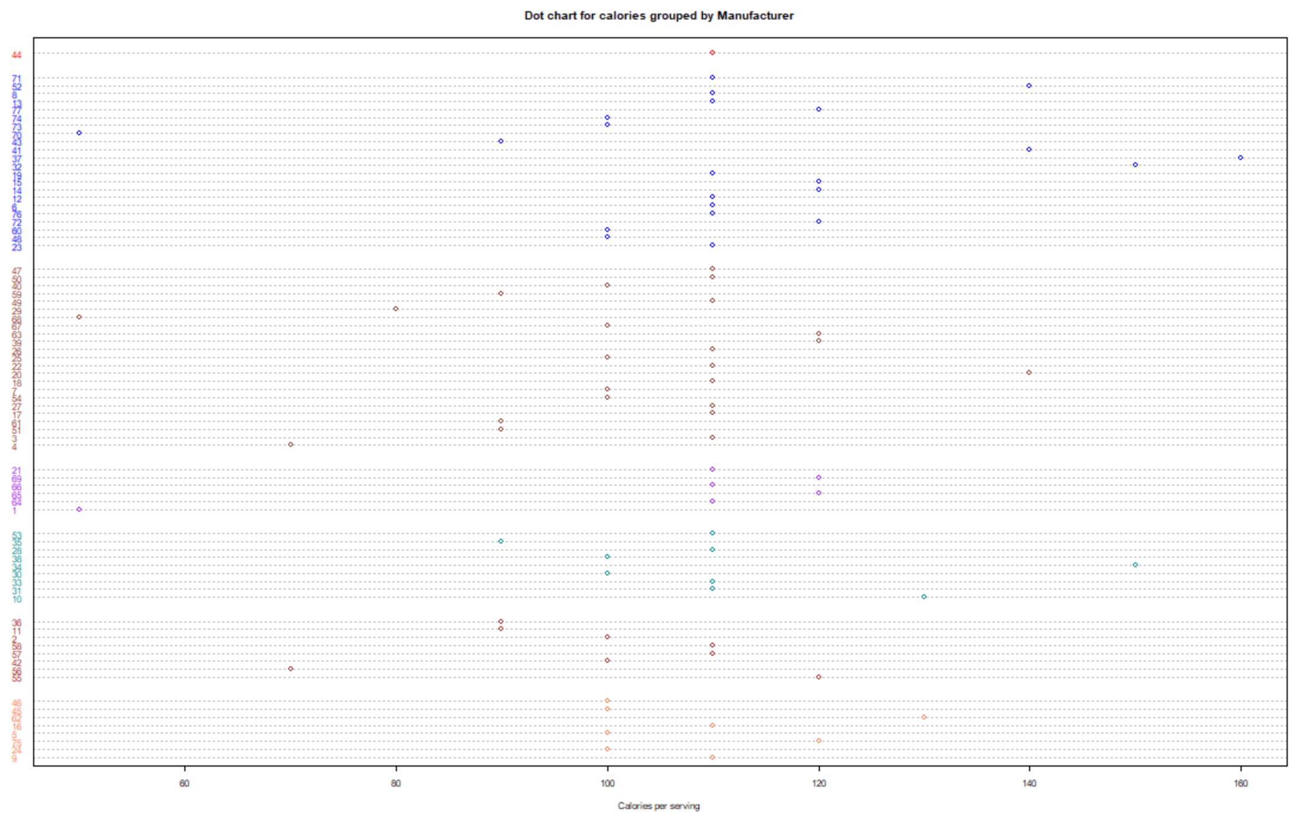

Calorie dot chart

Slide 6

Calorie Roadmap
Max. Daily Calorie need for weight loss*
Male: 2000
Female: 1500
150 Calorie
Muesli_Raisins,_Dates,_&_Almonds, Muesli_Raisins,_Peaches,_&_Pecans are the product with highest calories.
50 calorie
All-Bran_with_Extra_Fiber,
Puffed_Rice,
Puffed_Wheat
Consumer
More concern to weight gain. They prefer the products which help in weight reduction..
6gms
Cheerios, Special_K are the products with highest protein content. however, both have poor ratings because of high calories per serving
Fats
As cereals breakfast is a diet preferable food most of its fats ranges in the 0 to 2gms, whereas only 6 products as 4-5gms

Slide 7

Since we create certainty out of uncertainty…..
UNCERTAINTY
Certainty
What products one should use?
What products one should avoid?
Which product can help in weight loss?
What kind of product one should take in breakfast?
According to various consumer surveys , All-Bran_with_Extra_Fiber is the highest rated product. It is highly recommended to use. However, Nabisco has highest mean rating. It is safe to use its product.
Cap ‘n’ Crunch is the lowest rated product. One should avoid it.
A product with less calories and high protein can help in weight loss. All-Bran_with_Extra_Fiber is having least calories(50 calories) and a good amount of protein (4gm) and recommended for weight loss.
Products contain high protein, low calories, low fat and high fiber are recommended to consume in breakfast. All-Bran_with_Extra_Fiber ia having all the elements.

Slide 8
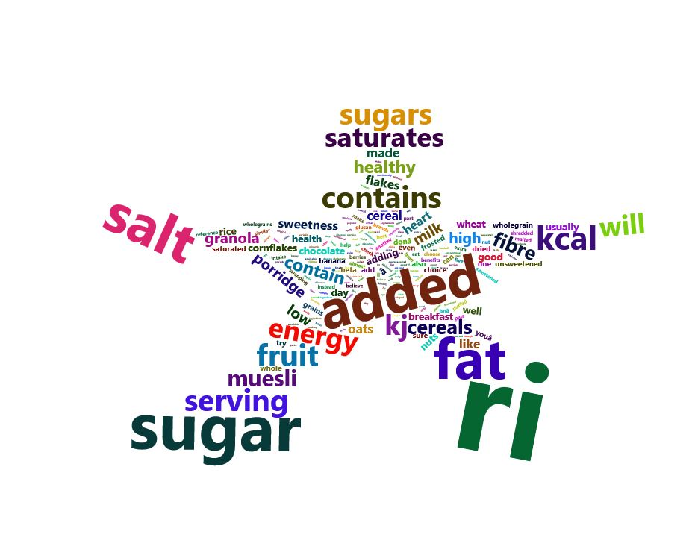
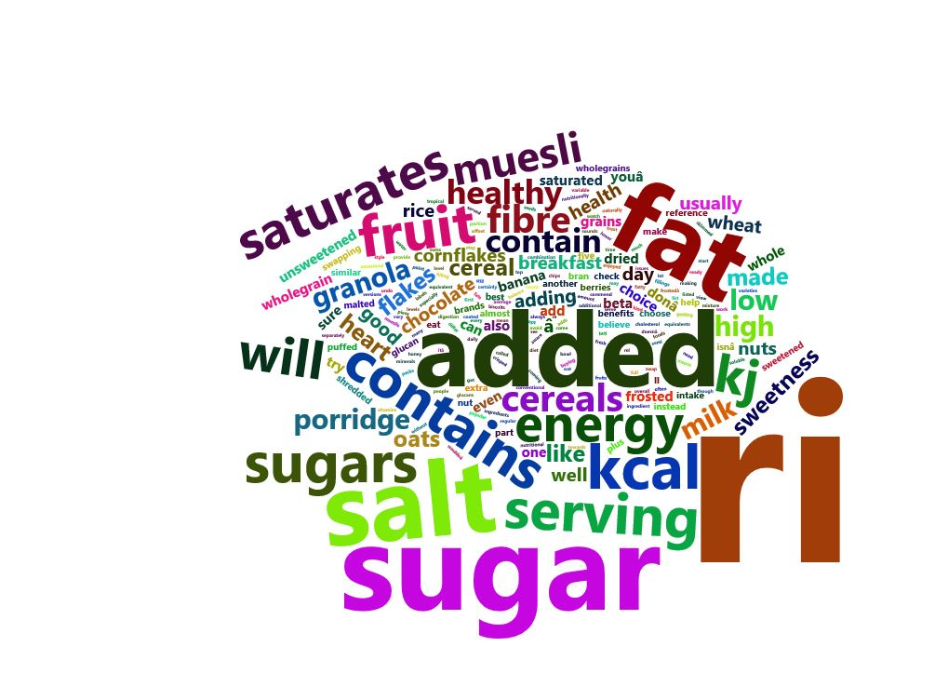
Word Cloud
Star
Pentagon

Slide 9
Reference Links And Scripts
https://www.ncbi.nlm.nih.gov/pmc/articles/PMC4499482/
https://www.nhs.uk/live-well/healthy-weight/understanding-calories/

Slide 10
Thank you
Data innovator
datainnovator210@gmail..com
https://datainnovators210.wixsite.com/data
we create certainty out of uncertainty.

